Slide 1
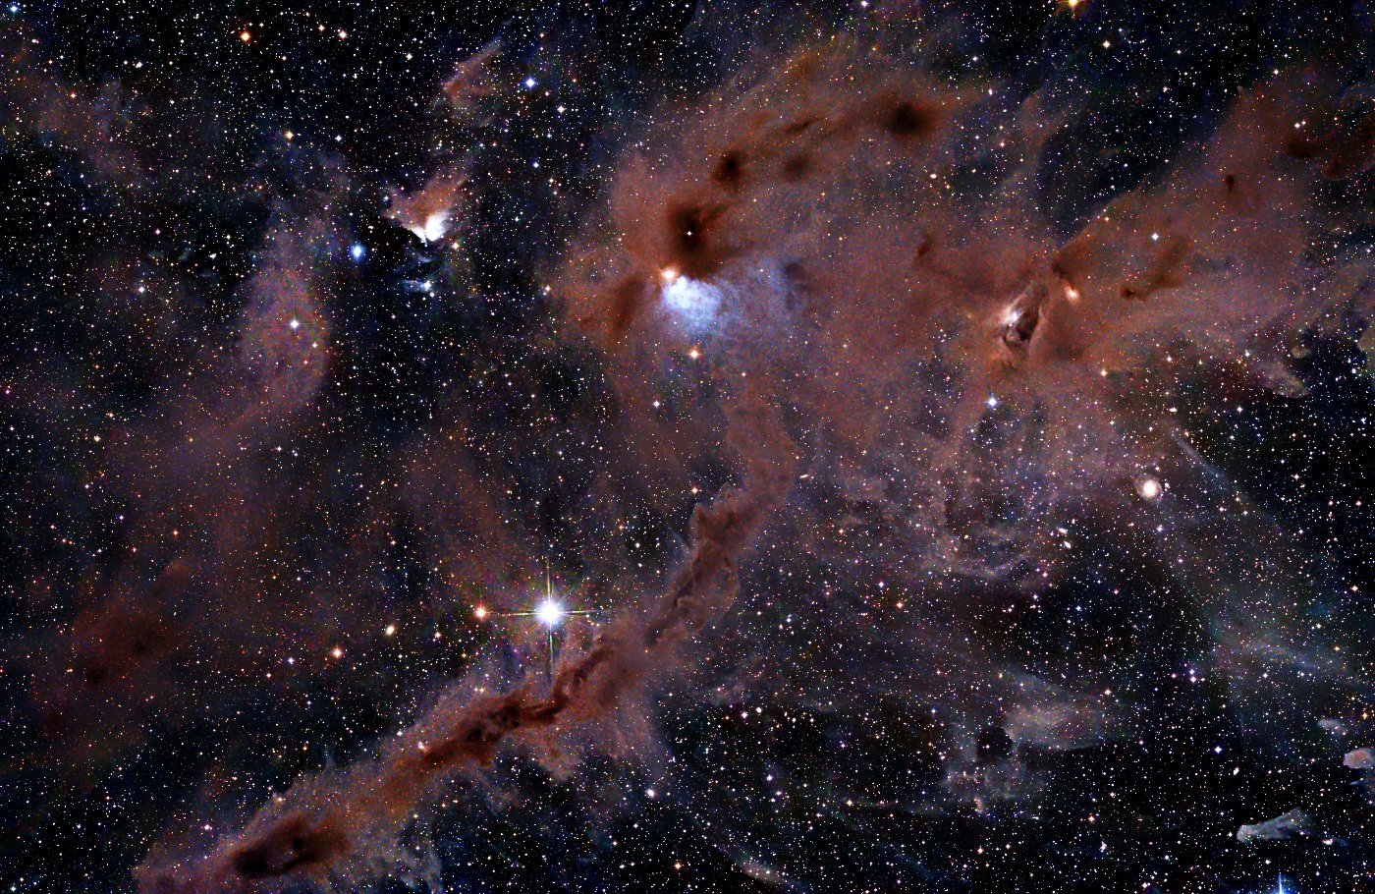



Mapping HCN within the L1495 Filament in the Taurus Molecular Cloud as a Probe for Large-Scale Flow
Megan Harrison
Advised by Dr. Yancy Shirley, University of Arizona
Arizona Space Grant Symposium, Arizona State University
April 19, 2025

Slide 2
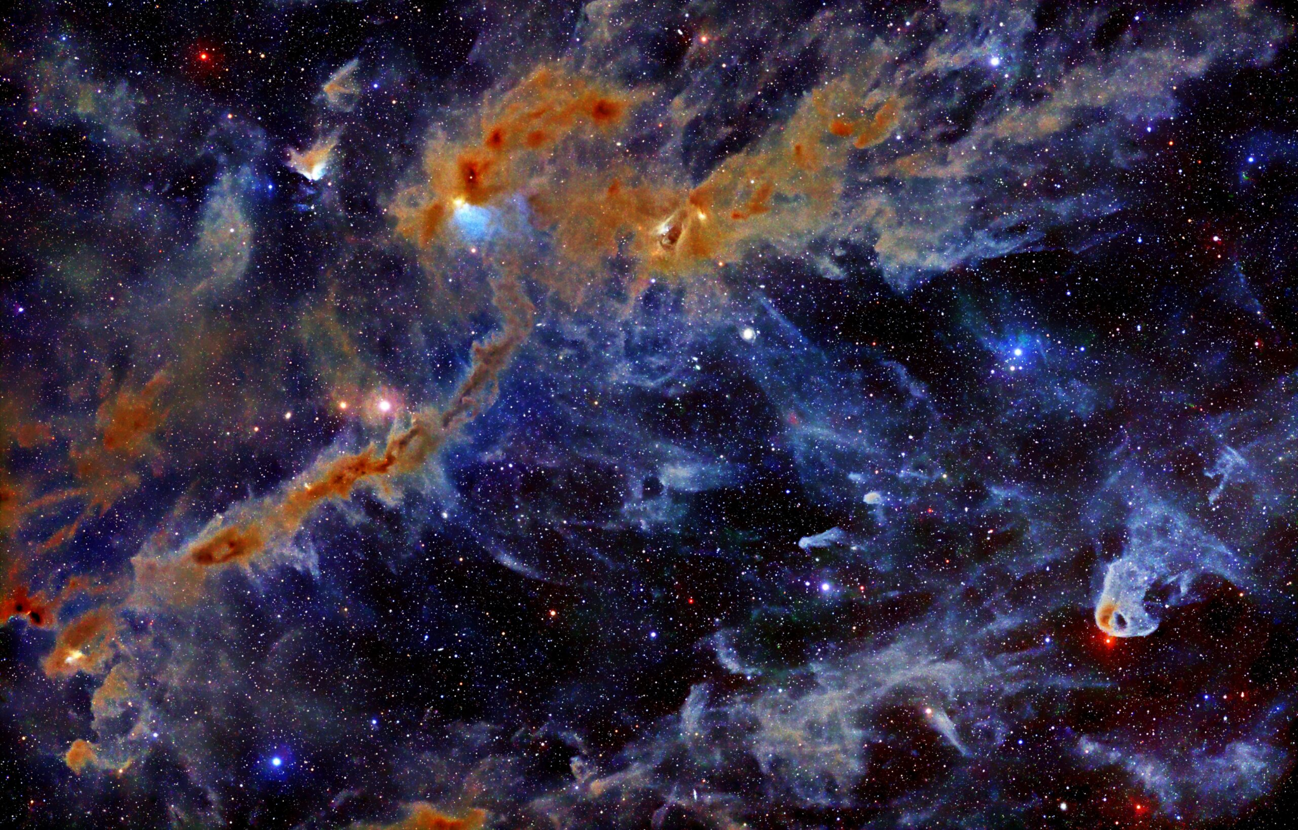
Molecular Clouds
Star-forming regions consisting of filaments and cores that are filled with cold, dense gas such as HCN
Studying the movement of gas allows us to understand how molecular clouds evolve through processes such as infall
We observe the gas through the unique elemental signature, or spectrum, that a molecule emits at
  The spectral lines are transitions different energy levels!

Slide 3
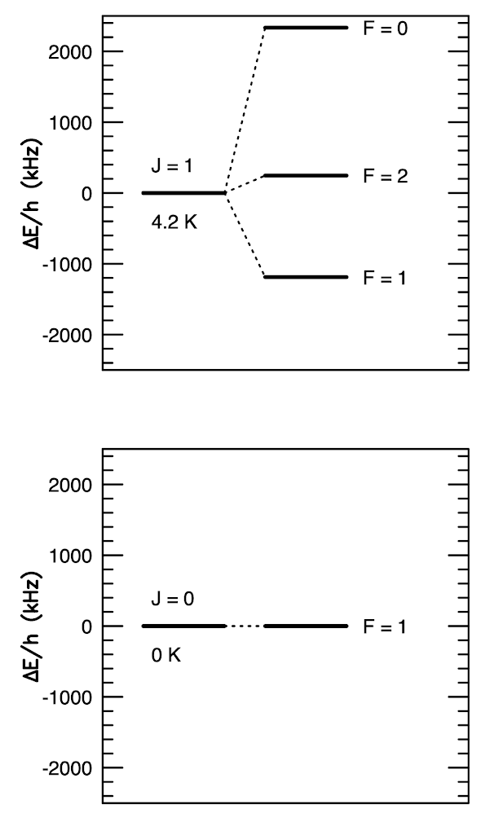
Rotational Transitions of HCN
Hyperfine energy levels
Energy levels can split into sublevels that we call hyperfine structure
We observe 3 transitions instead of 1
HCN is optically thick, meaning that HCN can self-absorb from other HCN
  This leads to blue and red asymmetries in the HCN spectrum
We calculate intensity to study gas flow
Rotational energy level

Slide 4
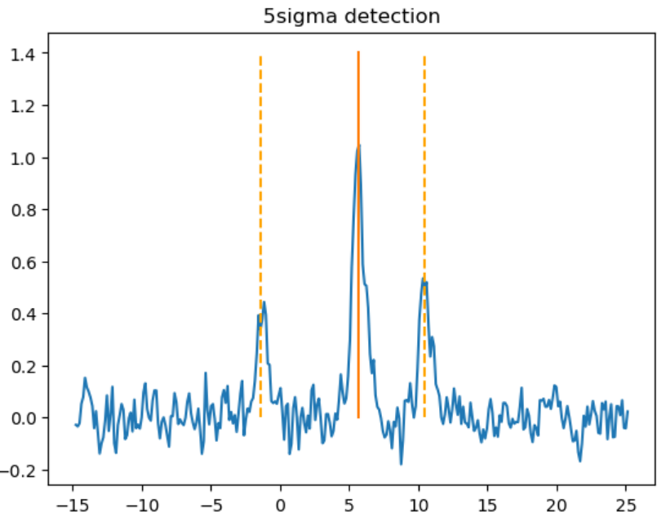
Rotational Transitions of HCN
Center
Energy levels can split into sublevels that we call hyperfine structure
We observe 3 transitions instead of 1
HCN is optically thick, meaning that HCN can self-absorb from other HCN
  This leads to blue and red asymmetries in the HCN spectrum
We calculate intensity to study gas flow
Right
Temperature (K)
Left
Velocity (km/s)

Slide 5
Rotational Transitions of HCN
Energy levels can split into sublevels that we call hyperfine structure
We observe 3 transitions instead of 1
HCN is optically thick, meaning that HCN can self-absorb from other HCN
  This leads to blue and red asymmetries in the HCN spectrum
We calculate intensity to study gas flow
v_{NH3}
Temperature (K)
Velocity (km/s)

Slide 6
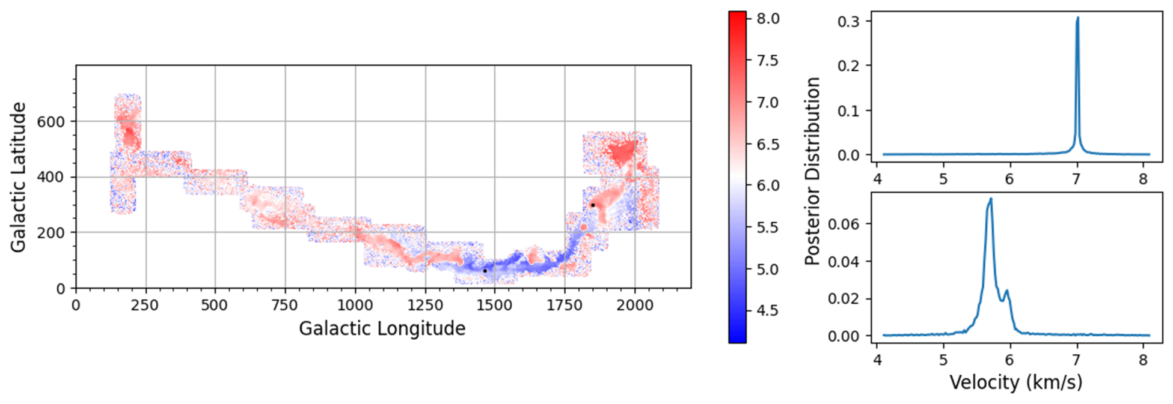
Maximum Likelihood Velocity
The maximum likelihood velocity of NH₃ is used to determine where to integrate for HCN intensity
While the spacing between the hyperfine lines of HCN is known, the NH₃ velocity fits perfectly with the center hyperfine line peak
Steffes et al., in prep

Slide 7
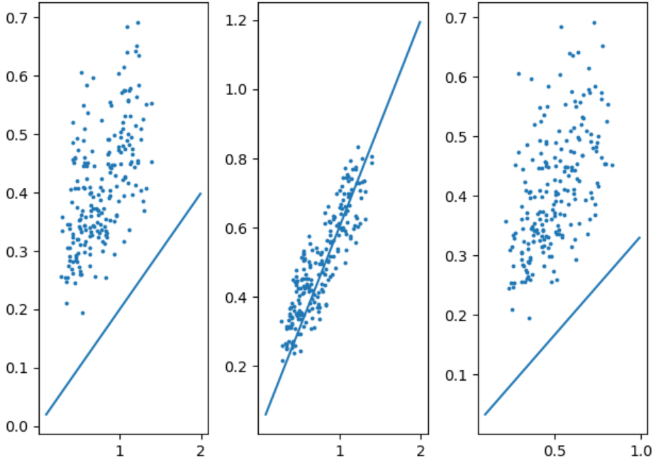
Hyperfine Line Ratios
Intensity Ratios
Left
Right
Left
The optically thin ratio between lines is 1-5-3
Left hyperfine line is stronger on average than anticipated for optically thin emission
Evidence for optically thick spectra and anomalous hyperfine ratios
Center
Center
Right

Slide 8
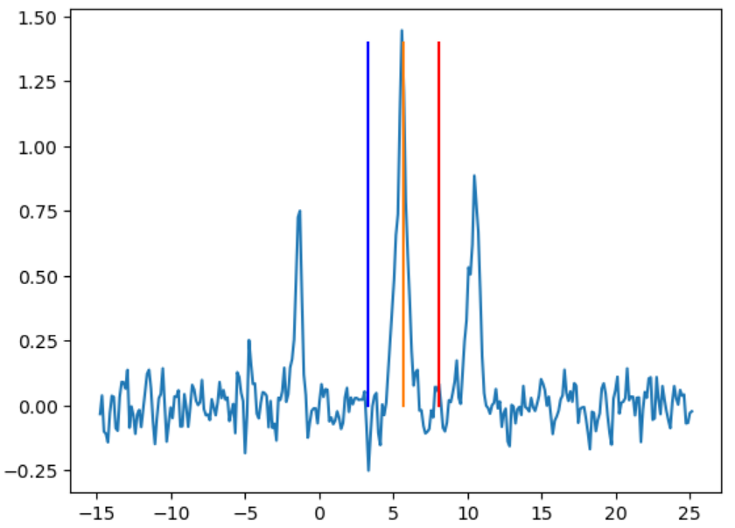

Hyperfine Line Intensity
Blue
Red
One measure of large-scale flow is blue excess, where the blue side of the spectral line is brighter than the red side
Calculated by finding the total, blue, and red integrated intensities, which are dependent on velocity and temperature of the gas
Use 5σ intensities to calculate
Temperature (K)
Velocity (km/s)

Slide 9
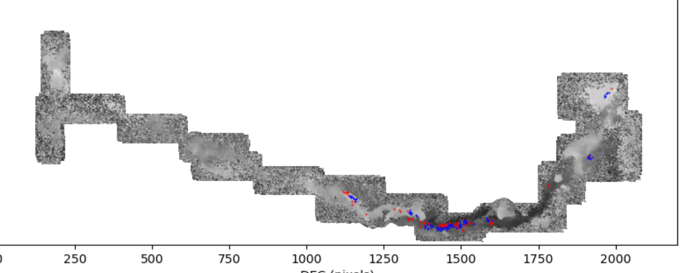
Blue Versus Red Asymmetries
More red asymmetries observed, meaning there’s cold gas moving in front of the hot gas
Along the center hyperfine line, there are more blue asymmetries
Blue excess was found to be 0.0952 along the center hyperfine line
Further analysis regarding the implications of these results is being done
Galactic latitude
Galactic longitude

Slide 10
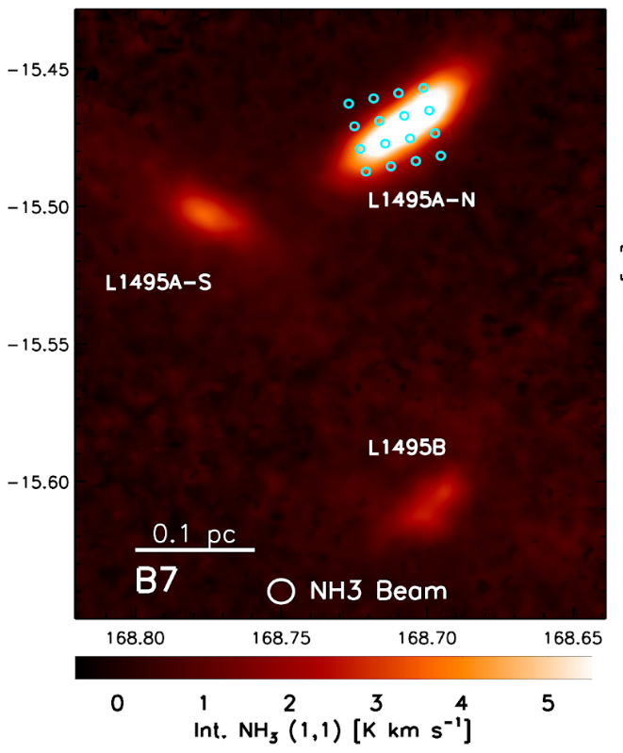
Conclusions
A previously studied core in the B7 region has an infall signature, or blue asymmetry, that my results match (Seo et al., 2019)
  We can analyze this further to probe gas flow
Seo et al., 2019

Slide 11
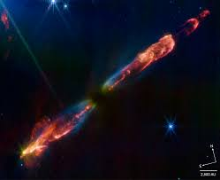
Conclusions
Systematic blue-red offsets in B13
Two possibilities: protostar jet outflow or an offset between HCN and NH₃
  These are both currently being examined further
Ray et al., 2023

Slide 12
Acknowledgements
Thank you to the Shirley Group (Lucy Steffes, Hanga Andras-Letanovszky, Hannah Gruber, Emma Vertachnik, Jack Hoskins) and the Shirley Radio Group Project for supporting over the course of this project. This project was funded by NASA, the Arizona Space Grant Consortium, National Science Foundation Astronomy and Astrophysics Grant (AAG) AST-2205474. The 12m Telescope is operated by the Arizona Radio Observatory (ARO) at Steward Observatory, with funding from the State of Arizona and multiple NSF grants.

Slide 13
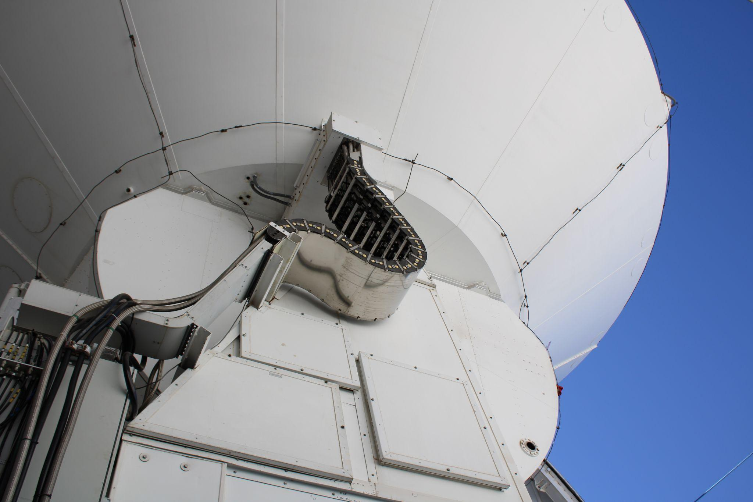

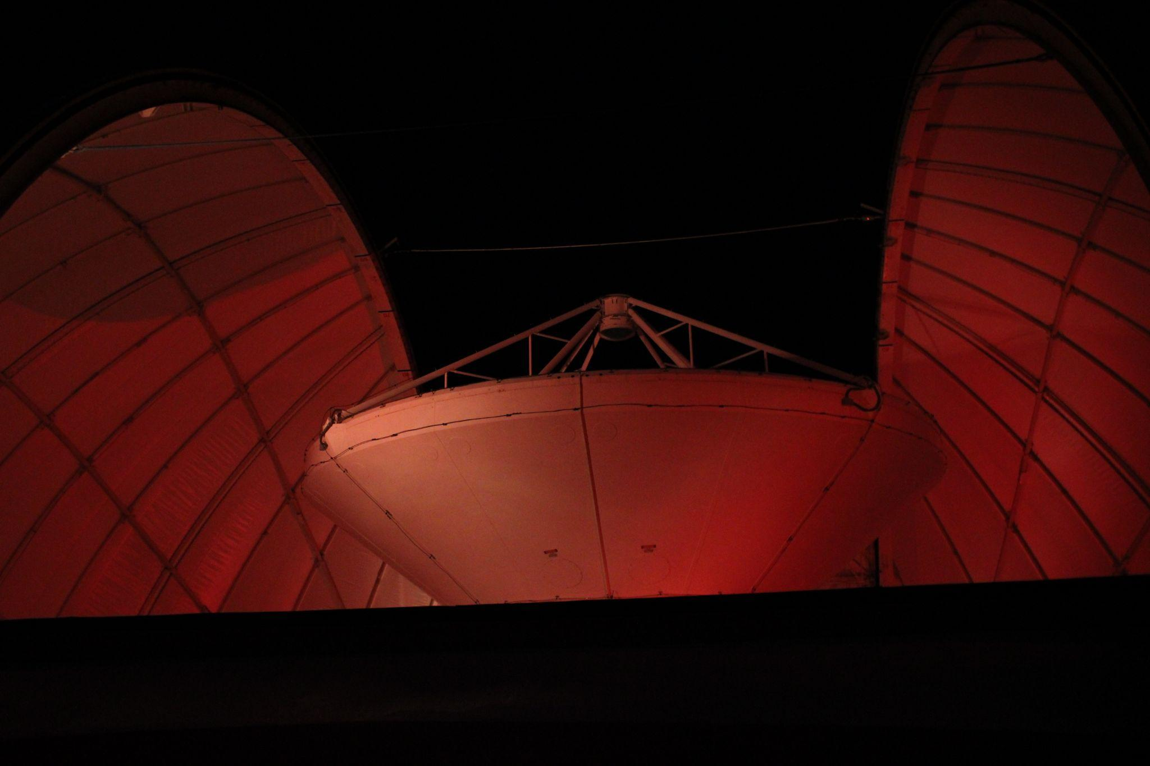
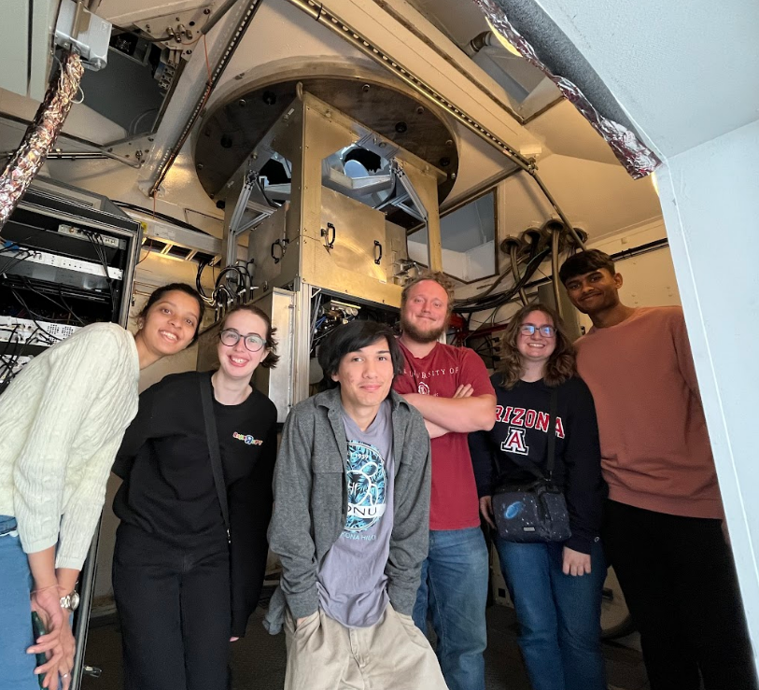
Thank You!

Slide 14
Backup Slides

Slide 15
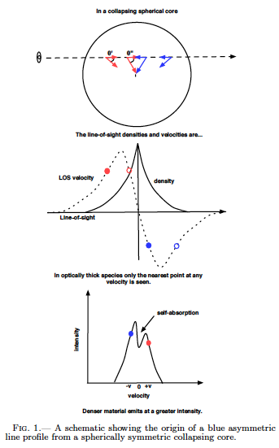
Infall
Gravity pulls gas inwards, causing a core to collapse; this is infalle
We can observe this gas as moving either towards (blue asymmetry) or away (red asymmetry) from us
If optically thick, we see blue asymmetries from more dense regions where infall could potentially be occurring
Smith et al., 2012

